Slide 1
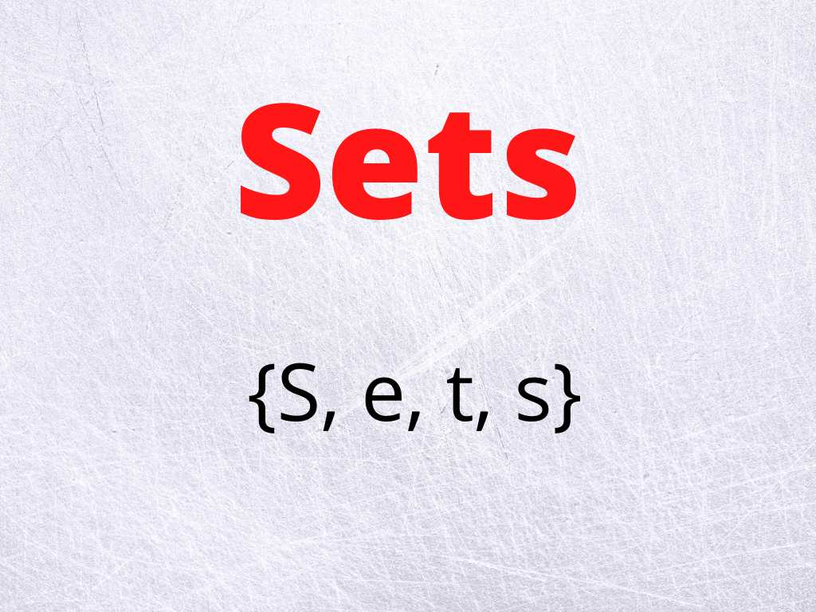

Slide 2
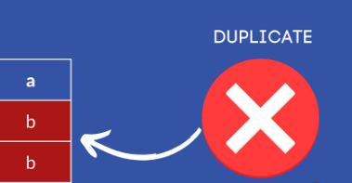


Slide 3
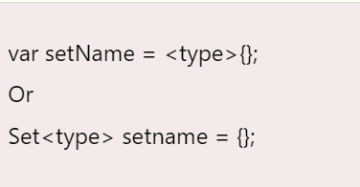
Dart Initializing Set
Here is a simple Dart set, created using a set literal:
To create an empty set, use {} preceded by a type argument, or assign {} to a variable of type Set:

Slide 4
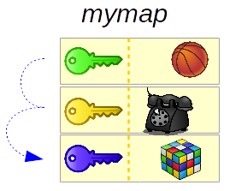
MAP

Slide 5
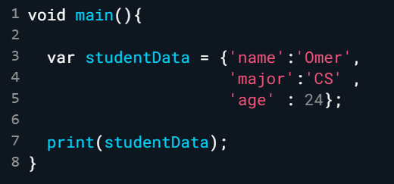
Dart Initializing Map

Slide 6
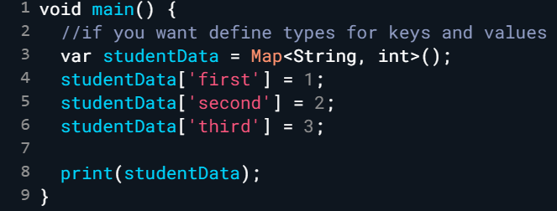
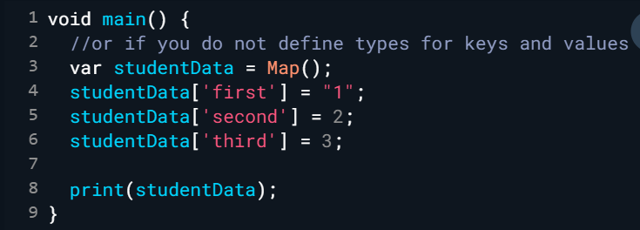
Dart Initializing Map (Cont.)
You can create the same objects using a Map constructor:

Slide 7
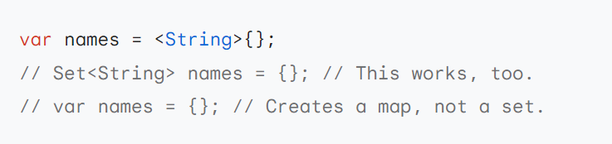
Set or map?

